Slide 1

DISEASE PREDICTION
USING
NAIVE BAYES
Final Phase Review

Slide 2
Under the supervision of,
Dr. Bondu Venkateswarlu
Associate Professor
Dept. of CSE
From “5th” SEM “D” SEC
MOHAMMED TAHEER - (ENG19CS0186)

Slide 3
Introduction
Disease Prediction using Naive Bayes is a system which predicts the disease of the patient or the user based on the symptoms he/she enters.
It provides the accurate results based on that information.
The health industry can also be benefit from this system by just asking the symptoms from the user and entering it in the system.
The project disease prediction using machine learning is developed to overcome general disease in earlier stages.
According to research there are 40% peoples who ignores about general disease which leads to harmful disease later.
This project is completely done with the help of Machine Learning and Python Programming language.

Slide 4
Problem definition
In a day's in Health Industry there are various problems related to machines or devices which will give wrong or unaccepted results. We are building a project that will give the accurate predictions based on information provided by the user and also based on the datasets that are available in the machine.

Slide 5
Objectives
The purpose of making this project called "Disease Prediction Using Naive Bayes" is to predict the accurate disease of the patient using all their general information and also the symptoms. If this Prediction is done at the early stages of the disease with the help of this project and all other necessary measure the disease can be cured.
The general purpose of this Disease prediction is to provide prediction for the various and generally occurring diseases that when unchecked and sometimes ignored can turns into fatal disease.

Slide 6
IMPLEMENTATION

Slide 7
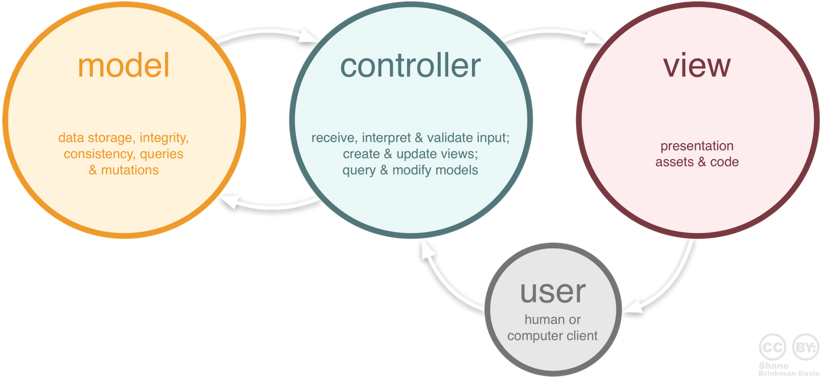
MVC Framework

Slide 8
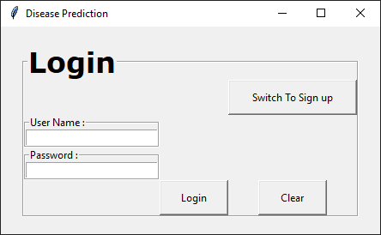
View
import tkinter as tk
class View(tk.Frame):
@abstractmethod
def create_view(self):
raise NotImplementedError
class Login(View):
def __init__(self, master=None):
super().__init__(master)
self.master = master
self.entries = {}
self.buttons = {}
def create_view(self):
control_frame = tk.LabelFrame(master, text="Login")
self.create_entry(control_frame, "User Name :", row=1, column=0, textvar=tk.StringVar())
self.create_entry(control_frame, "Password :", row=2, column=0, textvar=tk.StringVar())
self.create_button(control_frame, "Login", row=3, column=1, height=2, width=10)
self.create_button(control_frame, "Clear", row=3, column=2, height=2, width=10)
self.create_button(control_frame, "Switch To Sign up", row=0, column=2, height=2, width=20)
def create_entry(self, frame, label, row, column, textvar)
def create_button(self, frame, name, row, column, height, width)

Slide 9
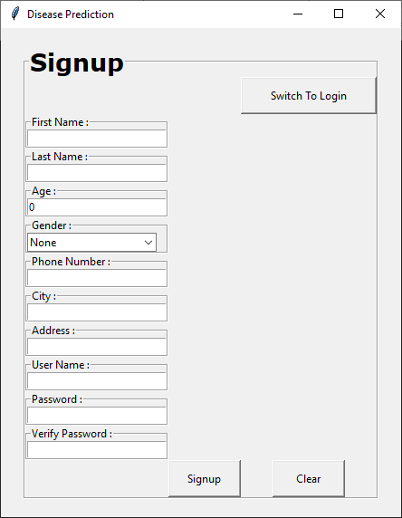
View
class Signup(Login):
def __init__(self, master=None):
super().__init__(master)
self.master = master
self.comboboxes = {}
def create_view(self):
#Cresting Entries
First Name,Last Name,Age,Gender,Phone Number,City,
Address,User Name,Password,Verify Password
self.create_button( "Signup")
self.create_button("Clear")
self.create_button("Switch To Login")
def create_combobox(self, frame, label, values, row, column)
def create_entry_show(self, frame, label, row, column, textvar)

Slide 10
View
class DiseasePrediction(Signup):
def __init__(self, master=None):
self.diseaseName = None
def create_view(self, symptomslist, patient_list):
#Creating Frame for Enter Symptoms
#Creating Label for Symptom 1,Symptom 2,Symptom 3,Symptom 4,Symptom 5.
self.create_combobox("S1En", values=symptomslist)
self.create_combobox("S2En", values=symptomslist)
self.create_combobox("S3En", values=symptomslist)
self.create_combobox("S4En", values=symptomslist)
self.create_combobox("S5En", values=symptomslist)
self.create_button(name="Predict Disease")
self.create_button(name="Clear")
#Creating Frame for Disease Predicted
self.diseaseName = self.create_label(text="___Disease Name___")
#Creating Frame for Patient Details
self.create_entry("Name: ")
self.create_entry("Age: ")
super().create_combobox("Gender: ", values=["Male", "Female"])
super().create_combobox("Already Entered Patients: ", values=patient_list)
def create_combobox(self, frame, label, values, row, column)
def create_label(self, frame, row, col, justify, text, font, fontsize, padx, pady)

Slide 11
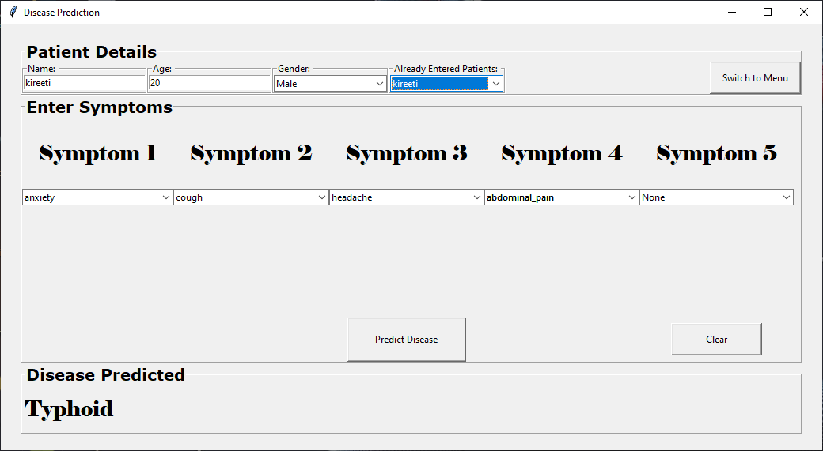
View

Slide 12
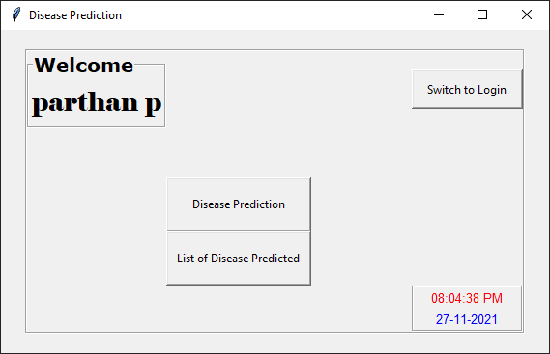
View
class Menu(DiseasePrediction):
def __init__(self, master=None):
super().__init__(master)
self.user_name = None
self.time = None
self.date = None
def create_view(self, user_name):
self.user_name = user_name
#Creating Frame for Welcome
self.create_button(name="Switch to Login")
self.create_button(name="Disease Prediction")
self.create_button(name="List of Disease Predicted")
#Creating Frame for Time and Date
self.time = tk.Label(text="")
self.date = tk.Label(text="")

Slide 13
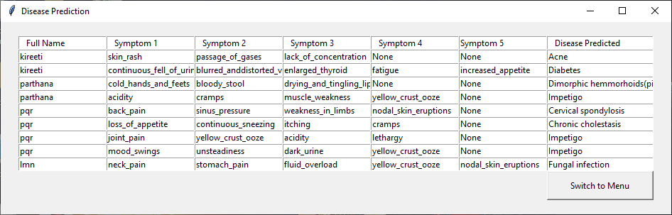
View
class Table(DiseasePrediction):
def __init__(self, master=None):
super().__init__(master)
def create_view(self, list):
total_rows = len(list)
total_columns = len(list[0])
self.create_button(name="Switch to Menu")
for row in range(total_rows):
for col in range(total_columns):
entry = tk.Entry(frame, width=20)
entry.insert(tk.END, list[row][col])

Slide 14
Model
from gui.lists import l1, replace
from sklearn.naive_bayes import MultinomialNB
import pymysql,import pandas as pd,import numpy as np,import time as t
class Model: #Class 'Model' for Multinomial Naive Bayes Algorithm
def __init__(self, training_datafile="gui/Training.csv", testing_datafile="gui/Testing.csv"):
self.df = pd.read_csv(training_datafile)
self.tr = pd.read_csv(testing_datafile)
self.naive_bayes = MultinomialNB()
self.X = None,self.y = None,self.X_test = None,self.y_test = None,self.model = None
def split(self):
replace(self.df)
self.X = self.df[l1]
self.y = self.df[["prognosis"]]
replace(self.tr)
self.X_test = self.tr[l1]
self.y_test = self.tr[["prognosis"]]
def fit(self):
self.model = self.naive_bayes.fit(self.X, np.ravel(self.y))
def predict(self, inputtest):
result = self.naive_bayes.predict(inputtest)
return result[0]

Slide 15
Model
class CurrentUser:
def __init__(self):
self.current_user_id = None
self.current_patient_id = None
self.current_symptoms_disease_id = None
self.current_patients = None
def set_user_id(self, current_user_id)
def get_user_id(self)
def store_db(self, symptoms, paitentdetails, disease_name):
[date, time] = self.date_time()
con = pymysql.connect(host, user, password,database="DiseasepredictionDB")
cur = con.cursor()
cur.execute("select * from patient_info where full_name=%s and id=%s",
(paitentdetails["Name: "].get(), self.current_user_id))
row = cur.fetchone()
if row is None:
# full_name,age,gender,id,patient_date and patient_time are insert into patient_info table
cur.execute("select id_2 from patient_info where patient_date=%s and patient_time=%s",(date, time))
(self.current_patient_id,) = cur.fetchone()
#id_2,symptom_1,symptom_2,symptom_3,symptom_4,symptom_5,disease,sym_date and sym_time are insert into sym_dis table.

Slide 16
Model
cur.execute("(select id_3 from sym_dis where sym_date=%s and sym_time=%s)", (date, time))
(self.current_symptoms_disease_id,) = cur.fetchone()
else:
isDone = True
while isDone:
try:
#id_2,symptom_1,symptom_2,symptom_3,symptom_4,symptom_5,disease,sym_date and sym_time are insert into sym_dis table.
isDone = False
except Exception as es:
self.current_patient_id = row[0]
cur.execute("(select id_3 from sym_dis where sym_date=%s and sym_time=%s)", (date, time))
(self.current_symptoms_disease_id,) = cur.fetchone()
return [True, "Success", "Information Successful Stored"]
def date_time(self):
return [date, time]

Slide 17
Model
def patient_selected(patient_name):
cur.execute("select full_name,age,gender from patient_info where id=%s and full_name=%s",
(current_info.get_user_id(), patient_name))
row = cur.fetchone()
return row
def current_patients():
cur.execute("select full_name from patient_info where id=%s", (current_info.get_user_id()))
row = cur.fetchall()
return row
def fetchinfo():
cur.execute("select first_name,last_name from user_information where id = %s", current_info.get_user_id())
row = cur.fetchone()
return row
def fetchlist():
cur.execute("select p.full_name, s.symptom_1, s.symptom_2, s.symptom_3, s.symptom_4, s.symptom_5, s.disease from "
"patient_info p, sym_dis s where p.id_2 = s.id_2 and p.id = %s", current_info.get_user_id())
row = cur.fetchall()
return row

Slide 18
Model
current_info = CurrentUser()
def logindb(entries):
cur.execute("select * from user_information where username=%s and password = %s",
(entries["User Name :"].get(), entries["Password :"].get()))
row = cur.fetchone()
if row is None:
return [False, "Error", "Invalid User Name And Password"]
else:
current_info.set_user_id(current_user_id=row[0])
return [True, "Success", "Successfully Login"]
def signupdb(entries, gender_value):
cur.execute("select * from user_information where username=%s", entries["User Name :"].get())
row = cur.fetchone()
if row is not None:
return [False, "Error", "User Name Already Exits"]
else:
#first_name,last_name,age,gender,phone_number,city,address,username and password are insert into user_information table.
return [True, "Success", "Registration Successful"]

Slide 19
Controller
from gui.Views import Login, Signup, DiseasePrediction, Menu, Table
from gui.Models import logindb, signupdb, Model, current_info, fetchinfo, current_patients, patient_selected, fetchlist
from gui.lists import l1, disease
import numpy as np, import time, from abc import ABC, abstractmethod
import tkinter as tk, import tkinter.messagebox as tkmsg, from functools import partial
def msgbox(isError, title, msg, frame)
class Controller(ABC):
@abstractmethod
def bind(View):
raise NotImplementedError
class LoginController(Controller):
def __init__(self):
self.view = None, self.root = None
def bind(self, view, root):
self.view.create_view()
self.view.buttons["Login"].configure(command=partial(self.login, frame=self.view, entries=self.view.entries))
self.view.buttons["Clear"].configure(command=self.clear)
self.view.buttons["Switch To Sign up"].configure(command=self.signup)
def login(self, frame, entries):
# if user is present call menuwin() or not show user not found message.

Slide 20
Controller
def menuwin(self):
# Creating object for menu controller and menu
sc.bind(view, root)
def close(self):
self.clear(), self.root.destroy()
def clear(self)
def signup(self):
# Creating object for signup controller and signup
sc.bind(view, root)
class SignupController(LoginController):
def __init__(self):
def bind(self, view, root):
self.view.create_view()
self.view.buttons["Signup"].configure(command=partial(self.action, frame=self.view, entries=self.view.entries,
gender=self.view.comboboxes["Gender :"]))
self.view.buttons["Clear"].configure(command=partial(self.clear, iscombobox=True))
self.view.buttons["Switch To Login"].configure(command=self.switch)

Slide 21
Controller
def action(self, frame, entries, gender):
msgbox(True, "Error", "All Fields Are Required")
msgbox(True, "Error", "Enter Proper Phone Number")
msgbox(True, "Error", "Password & Confirm Password Should Be Same")
else:
try:
[isSuccess, title, msg] = signupdb(entries=entries, gender_value=gender)
msgbox(True, "Success", "Information is stored")
if isSuccess:
self.clear(iscombobox=True)
self.switch()
except Exception as es:
msgbox(True, "Error", f"Error Due to : {str(es)}", frame)
def clear(self, iscombobox)
def switch(self):
self.root.destroy(), self.loginwin()
def loginwin(self):
# Creating object for login controller and login
sc.bind(view, root)

Slide 22
Controller
class MenuController(SignupController):
def __init__(self):
self.isClockOn = True
def bind(self, view, root):
self.view.create_view(user_name=self.user_info())
self.clock(view=self.view)
self.view.buttons["Disease Prediction"].configure(command=self.dpwin)
self.view.buttons["List of Disease Predicted"].configure(command=self.listdp)
self.view.buttons["Switch to Login"].configure(command=partial(self.exit, gotologinwin=True))
def user_info(self):
return full_name
def dpwin(self):
self.exit(gotologinwin=False)
# Creating object for signup controller and signup
pc.bind(view, root)
def exit(self, gotologinwin):
self.isClockOn = False, self.root.destroy
if gotologinwin:
self.loginwin()

Slide 23
Controller
def listdp(self):
self.exit(gotologinwin=False)
# Creating object for signup controller and signup
tableCon.bind(view, root)
def clock(self, view):
view.time.config(text=hh + ":" + mm + ":" + ss + " " + ap)
view.date.config(text=day + "-" + month + "-" + year)

Slide 24
Controller
class PredictController(MenuController):
def __init__(self, model):
self.predicted_disease = ""
self.l2 = None
def bind(self, view, root):
self.l2 = current_patients()
self.view.create_view(diseaselist=l1, patient_list=self.l2)
self.view.buttons["Predict Disease"].configure(command=partial(self.predict, frame=self.view, symptoms=self.view.comboboxes,paitentdetails=self.view.entries))
self.view.buttons["Clear"].configure(command=self.clear)
self.view.buttons["Switch to Menu"].configure(command=self.exit)
self.view.comboboxes["Already Entered Patients: "].bind('<<ComboboxSelected>>', self.patient_changed)
def predict(self, frame, symptoms, paitentdetails):
msgbox(True, "Error", "ENTER PATIENT DETAILS PLEASE")
msgbox(True, "Error", "ENTER SYMPTOMS PLEASE")
else:
# Creating object of Naive Baies Algorithm
self.model.split()
self.model.fit()

Slide 25
Controller
user_input = self.inputtest(symptoms=self.view.comboboxes)
self.predicted_disease = self.model.predict(inputtest=user_input)
h = 'no'
for a in range(0, len(disease)):
if disease[self.predicted_disease] == disease[a]:
h = 'yes'
break
if h == 'yes':
self.view.diseaseName["text"] = disease[self.predicted_disease]
try:
[isSuccess, title, msg] = current_info.store_db(symptoms, paitentdetails,
disease_name=self.view.diseaseName["text"])
msgbox(not isSuccess, title=title, msg=msg, frame=frame)
except Exception as es:
msgbox(True, "Error", f"Error Due to : {str(es)}", frame)
else:
self.view.diseaseName["text"] = "No Disease"
def patient_changed(self, event):
p_name = self.view.comboboxes["Already Entered Patients: "].get()
(full_name, age, gender) = patient_selected(patient_name=p_name)
self.view.comboboxes["Gender: "].set(gender)
self.view.entries["Name: "].insert(0, full_name)
self.view.entries["Age: "].insert(0, age)

Slide 26
Controller
def exit(self):
super().exit(gotologinwin=False), self.menuwin()
def clear(self):
super().clear(iscombobox=True), self.view.diseaseName['text'] = "___Disease Name___"
def inputtest(self, symptoms):
l2 = []
for x in range(0, len(l1)):
l2.append(0)
psymptoms = [symptoms["S1En"].get(), symptoms["S2En"].get(), symptoms["S3En"].get(), symptoms["S4En"].get(),
symptoms["S5En"].get()]
for k in range(0, len(l1)):
for z in psymptoms:
if (z == l1[k]):
l2[k] = 1
return [l2]

Slide 27
Controller
class TableController(PredictController):
def __init__(self):
def bind(self, view, root):
self.view.create_view(data=self.table())
self.view.buttons["Switch to Menu"].configure(command=self.exit)
def table(self):
return final_table

Slide 28
Naïve Bayes Algorithm
The Design goals consist of various design which we have implemented in our system disease prediction using machine learning.
It is used to predict the categorical class labels.
It classifies the class data based on the training set and the values in a classifying attribute and uses it in classifying new data.
It is statistical method for classification and supervised learning method.
It can solve both categorical and continuous values attributes.
Bayes theorem finds the probability of an event occurring given the probability of another event that has already occurred. Bayes theorem is stated mathematically as the following equation.
P(A/B) = P(B|A) P(A)/P(B)

Slide 29
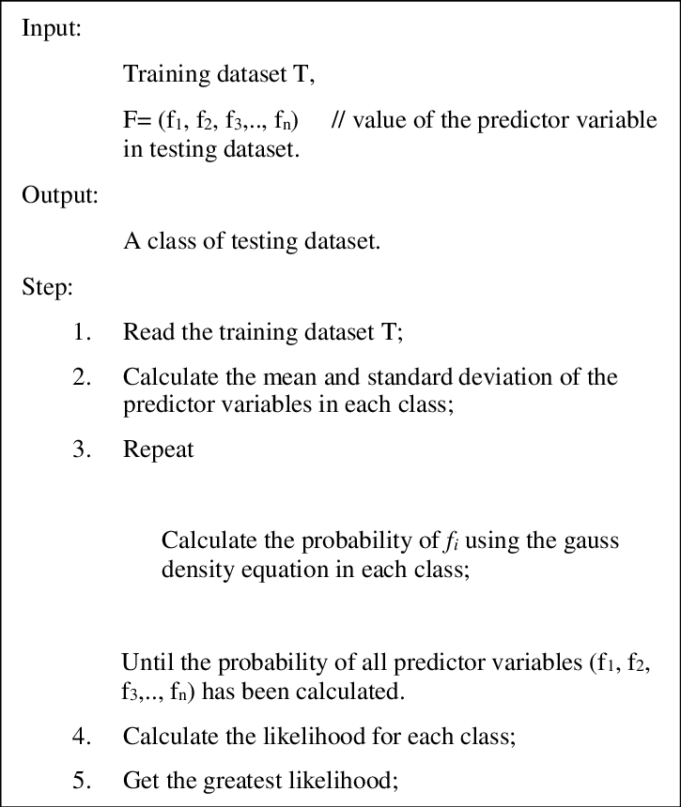
Naïve Bayes Algorithm

Slide 30
Result Analysis

Slide 31
Training Dataset

Slide 32
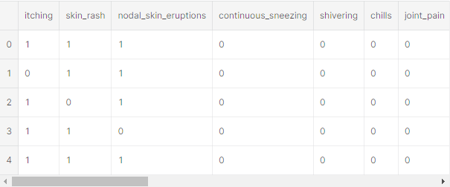
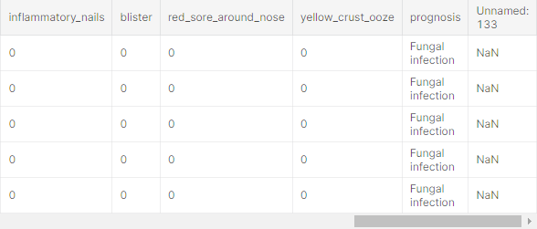
Training Dataset

Slide 33
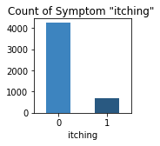
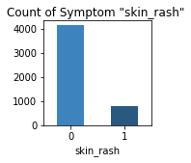
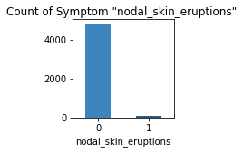
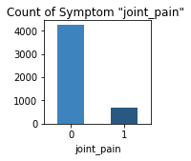
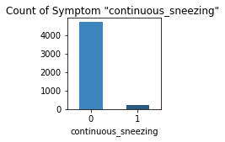
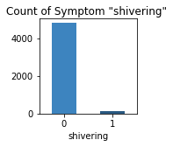
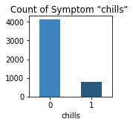
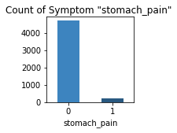
Barplot of the count for all symptoms' absence and presence in Training Dataset

Slide 34
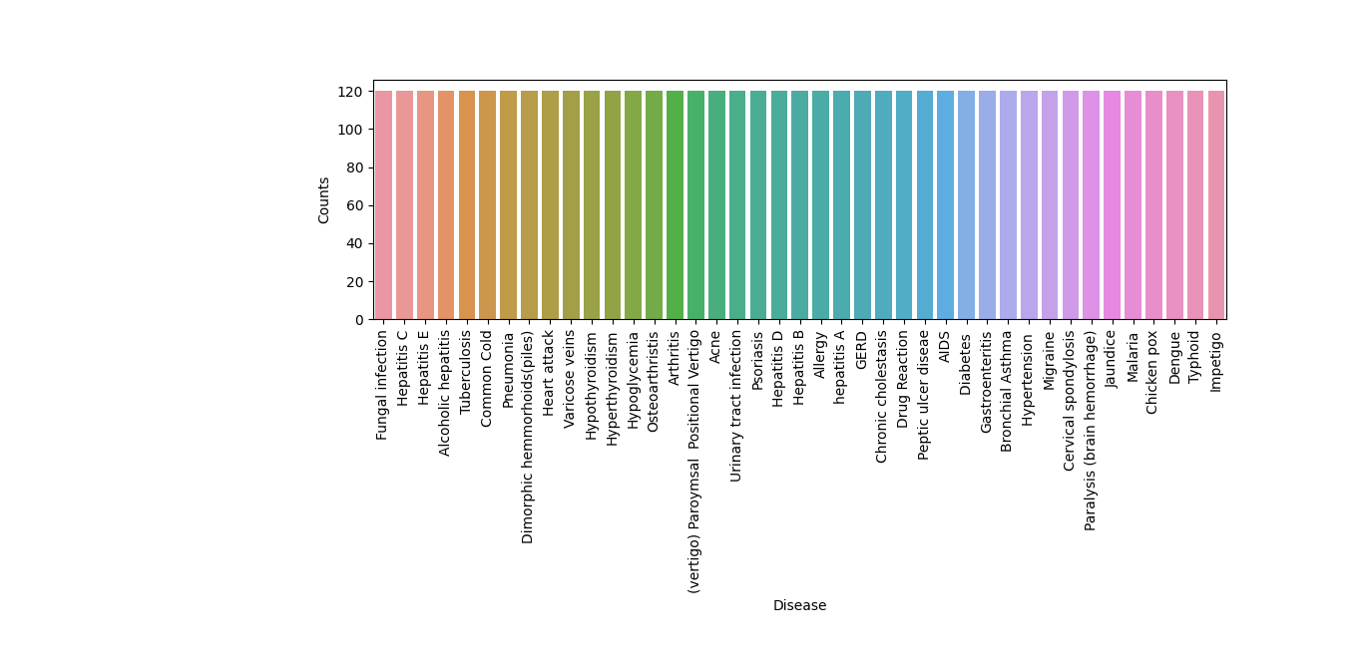
Barplot of the count for all diseases in Training Dataset

Slide 35
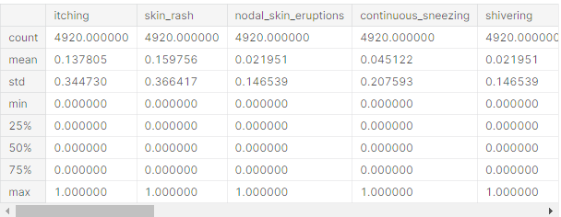
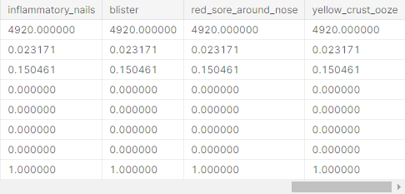
Summary statistics of attributes of Training Dataset

Slide 36
Testing Dataset

Slide 37
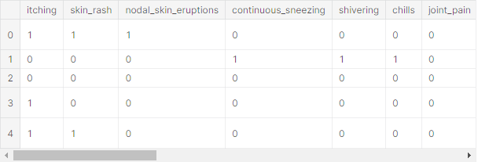
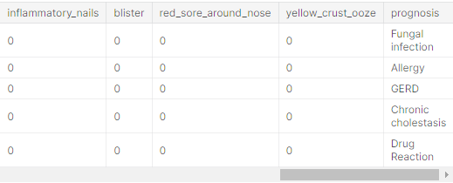
Testing Dataset

Slide 38
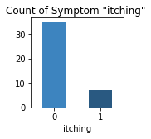


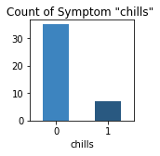
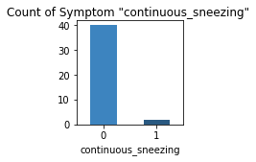



Barplot of the count for all symptoms' absence and presence in Testing Dataset

Slide 39
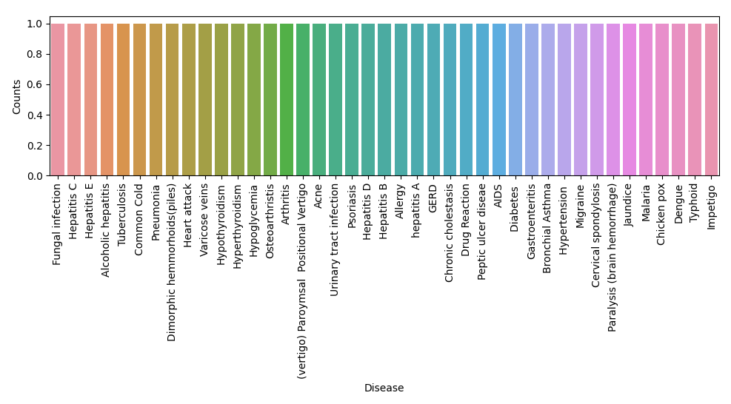
Barplot of the count for all diseases in Testing Dataset

Slide 40
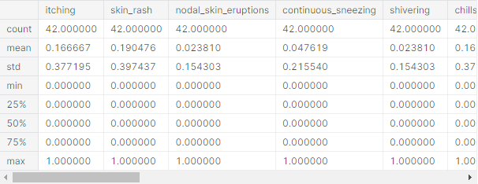
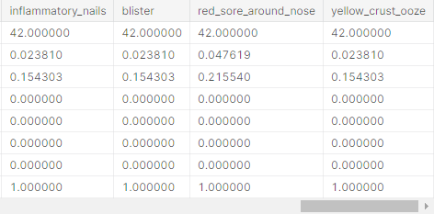
Summary statistics of attributes of Testing Dataset

Slide 41
Snapshots

Slide 42
Sign Window
Login Window

Slide 43
Menu Window

Slide 44
Table Window

Slide 45
Disease Prediction Window

Slide 46
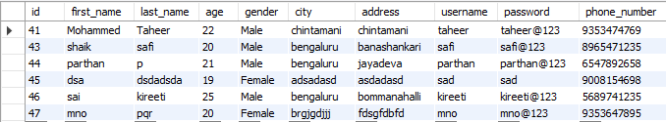
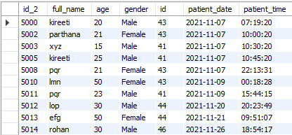
Database Tables
User Information
Patient Information

Slide 47
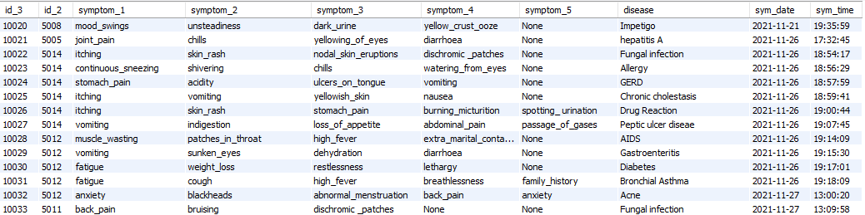
Database Tables
Symptoms and Disease table

Slide 48
Testing

Slide 49
Login Testing
SlNo | Input |  | Expected Output | Actual Output | Status
 | User Name | Password
1 | None | None | Enter User Name and Password | Enter User Name and Password | Pass
2 | Rohit | None | Enter User Name and Password | Enter User Name and Password | Pass
3 | None | Rohit123 | Enter User Name and Password | Enter User Name and Password | Pass
4 | Rohit | Rohit125 | Invalid Username And Password | Invalid Username And Password | Pass
5 | Rohit2 | Rohit123 | Invalid Username And Password | Invalid Username And Password | Pass
6 | Rohit | Rohit123 | Successfully Login | Successfully Login | Pass

Slide 50
Signup Testing
SlNo | Expected Input | Expected Output | Given Input | Given Output | Status
1 | Zero Fields Entered | All Fields Are Required | Zero Fields Entered | All Fields Are Required | Pass
2 | Partial Fields Entered | All Fields Are Required | Partial Fields Entered | All Fields Are Required | Pass
3 | Password Confirmation Field Entered wrong | Password And Confirm Password Should Be Same | Password Confirmation Field Entered wrong | Password And Confirm Password Should Be Same | Pass
4 | Password Confirmation Field Entered correct | Registration Successful | Password Confirmation Field Entered correct | Registration Successful | Pass

Slide 51
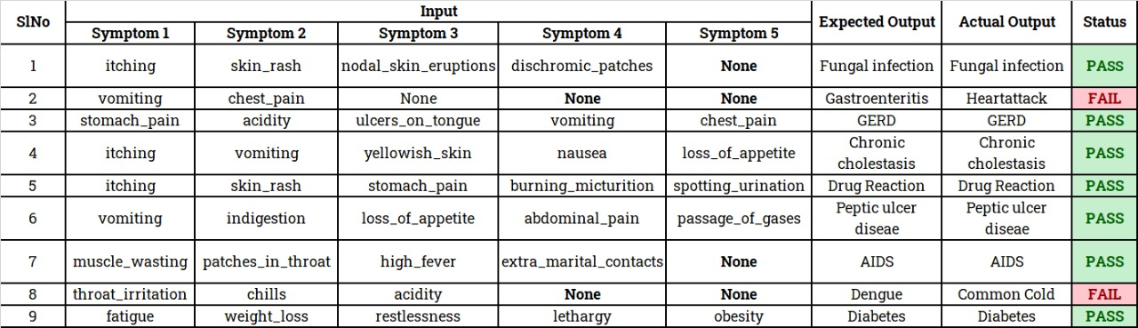
Disease Prediction Testing - 1

Slide 52
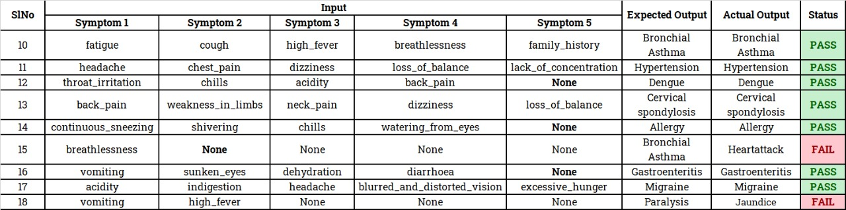
Disease Prediction Testing - 2

Slide 53
Literature Review

Slide 54
Sl.No | Publisher & Year | Author & Title | About the paper
1. | IJERT 2017 | Ajinkya Kunjir, Harshal Sawant, Nuzhat F.Shaikh. “Data Mining and Data Visualization for prediction of Multiple Diseases in Healthcare.” | They have proposed a best clinical decision-making system which predicts the disease on the basis of historical data of patients. In this predicted multiple diseases an unseen pattern of the patient condition was found.
Notes:
IJERT: International Journal of Engineering Research & Technology

Slide 55
Sl.No | Publisher & Year | Author & Title | About the paper
2. | IEEE 2019 | Anjan Nikhil Repaka, Sai Deepak Ravikanti, Ramya G Franklin. “Design And Implementation Heart Disease Prediction Using Naives Bayesian.” | A system was proposed using Naïve Bayes techniques for classification of dataset and Advanced Encryption Standard algorithm for secure data transfer for prediction of disease.

Slide 56
Sl.No | Publisher & Year | Author & Title | About the paper
3. | IJERT 2019 | Fahd Saleh Alotaibi. “Implementation of Machine Learning Model to Predict Heart Failure Disease.” | Author has designed a Machine Learning model comparing five different algorithms. Here Rapid Miner tool was used which resulted in higher accuracy compared to Matlab and Weka tool. In this research the accuracy of Decision Tree, Logistic Regression, Random forest, Naive Bayes and Support Vector Machine classification algorithms were compared. Decision tree algorithm had the highest accuracy.
Notes:
IJERT: International Journal of Engineering Research & Technology

Slide 57
Sl.No | Publisher & Year | Author & Title | About the paper
4. | IEEE 2017 | M. Chen, Y. Hao, K. Hwang, L. Wang, L. Wang “Disease prediction by machine learning over big data from healthcare communities.” | Authors have proposed a new convolutional neural network based multimodal disease risk prediction algorithm by using structured and unstructured data of hospital. Also, predicts that whether a patient experiences from the high risk of cerebral infarction or low risk of cerebral infarction. The accuracy of disease prediction reaches up to the 94.8% with faster speed than Convolutional neural network based unimodal disease risk prediction algorithm.

Slide 58
Sl.No | Publisher & Year | Author & Title | About the paper
5. | IEEE 2015 | B. Qian, X. Wang, N. Cao, H. Li, Y.-G. Jiang. “A relative similarity based method for interactive patient risk prediction.” | Authors have designed the disease risk prediction system with the help of Electronic Health Record data of the patient. The experts have identified the similar health conditions between the two patients and on this basis of that patient risk is evaluated.

Slide 59
Sl.No | Publisher & Year | Author & Title | About the paper
6. | IEEE 2017 | IM. Chen, Y. Ma, Y. Li, D. Wu, Y. Zhang, C. Youn. “Enable human-cloud integration in next generation healthcare system.” | This Research manages the huge amount of biomedical data. The system performed various operations on cloud-like data analysis, monitoring and prediction of the data. With the help of this system, a person gets more information about how to handle and manage the huge amount of biomedical data in the cloud. Also, the many services related to healthcare know by this system.

Slide 60
Functional Requirements
A Functional requirement defines a function of a system or its component.
On logging in the system as user, the user can carry out following functionalities of the system.
Entering Symptoms
Disease Prediction
Precautions
Step 1: Entering Symptoms : Once the user is logged in he/she can select the symptoms presented by them which are available in the drop-down box.
Step 2: Disease prediction : The predictive model predicts the disease a person might have based on the user entered symptoms.
Step 3: Precautions : The system also gives required precautionary measures to overcome a disease.

Slide 61
Non - Functional Requirements
Non-functional Requirements refer to the constraints or restrictions on the system.
Functional requirements drive the application architecture of a system, while non-functional requirements drive the technical architecture of a system.
Performance requirement: All data entered shall be up to mark and no flaws shall be there for the performance to be 100%.
Platform constraints: The main target is to generate an intelligent system to predicts the disease
Accuracy and Precision: Requirements are accuracy and precision of the data.
Security: One or more requirements about protection of your system and its data.
Usability: Requirements about how difficult it will be to learn and operate the system. The requirements are often expressed in learning time or similar metrics.

Slide 62
Requirements
Hardware Requirements:
System: Pentium 4, Intel Core i3, i5, i7 and 2 GHz Minimum
RAM: 512Mb or above
Hard Disk: 5 GB or above
Software Requirements:
Operating System: Windows 7, 10 or Higher Versions
Platform: Python IDE
Front End: Python Tkinter
Back End: Python, Database
Programming Lang: Python

Slide 63
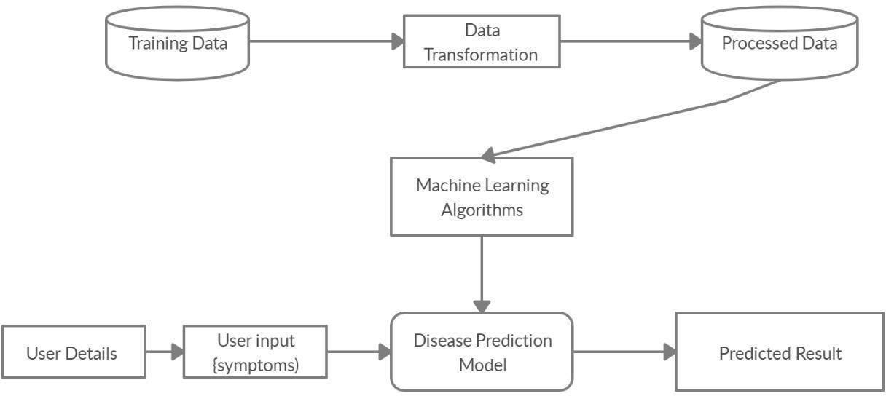
System Architecture

Slide 64
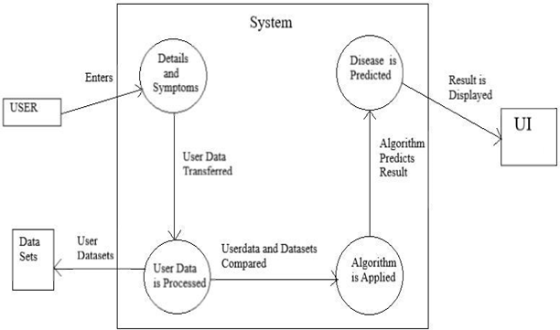
Data Flow Diagram

Slide 65
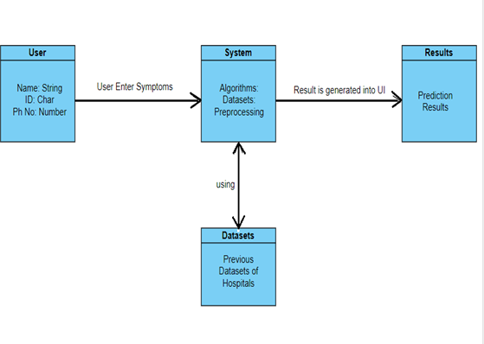
Class Diagram

Slide 66
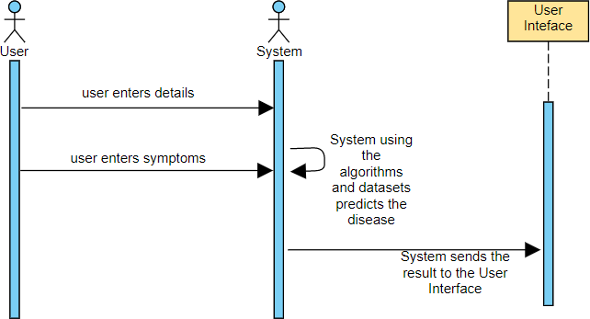
Sequence Diagram

Slide 67
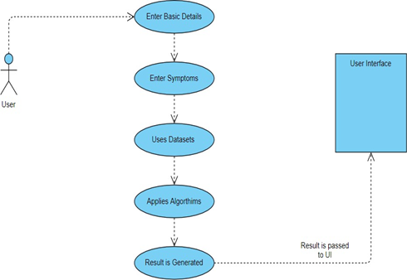
Use Case Diagram

Slide 68
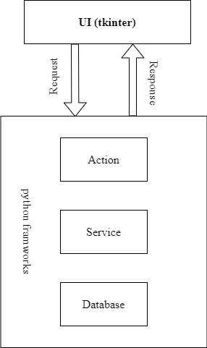
User Interface
The structure which we use in our project Disease Prediction using Machine learning.
The User Interface of this system consists of Python’s library interface called tkinter.
It also consists of Database system where all the user related information is stored such as username, password, age, phone, email.
This is the structure of the User Interface along with necessary implementations.

Slide 69
Conclusion
The main aim of this project is to predict the disease in accordance with symptoms put down by the patients with proper implementation of Machine Learning algorithm. In this project we have used one Machine Learning algorithm for prediction. It also stores the data entered by the user and the name of the disease the patient is suffering from in the Database which can be used as past record and will help in future for future treatment and thus contributing in easier health management. We have also created a GUI for better interaction with the system by users which is very easy to operate. This project shows that Machine Learning algorithm can be used to predict the disease easily with different parameters and models. In the end we can say that our system has no threshold of the users because everyone can use this system. Future Enhancement : Facility for modifying user detail, Facilities for Backup creation, Can be done as Web page.

Slide 70
References
Anjan Nikhil Repaka, Sai Deepak Ravikanti, Ramya G Franklin, ”Design And Implementation Heart Disease Prediction Using Naives Bayesian”, International Conference on Trends in Electronics and Information(ICOEI 2019).
Fahd Saleh Alotaibi,” Implementation of Machine Learning Model to Predict Heart Failure Disease”, (IJACSA) International Journal of Advanced Computer Science and Applications, Vol. 10, 2019.
M. Chen, Y. Hao, K. Hwang, L. Wang, and L. Wang, “Disease prediction by machine learning over big data from healthcare communities”, IEEE Access, vol. 5, 2017.
Ajinkya Kunjir, Harshal Sawant, Nuzhat F.Shaikh, “Data Mining and Visualization for prediction of Multiple Diseases in Healthcare”, in IEEE big data analytics and computational intelligence, 2017.
B. Qian, X. Wang, N. Cao, H. Li, and Y.-G. Jiang, “ A relative similarity based method for interactive patient risk prediction”, Data Mining Knowl.Discovery, vol. 29, 2015.
IM. Chen, Y. Ma, Y. Li, D. Wu, Y. Zhang, and C. Youn, “ Wearable 2.0: Enable human-cloud integration in next generation healthcare system”, IEEE Commun. , vol. 55, Jan. 2017.
S. Jadhav, R. Kasar, N. Lade, M. Patil, and S. Kolte, “Disease Prediction by Machine Learning from Healthcare Communities,” International Journal of Scientific Research in Science and Technology, 2019.

Slide 71

Thank You!!

